Slide 1
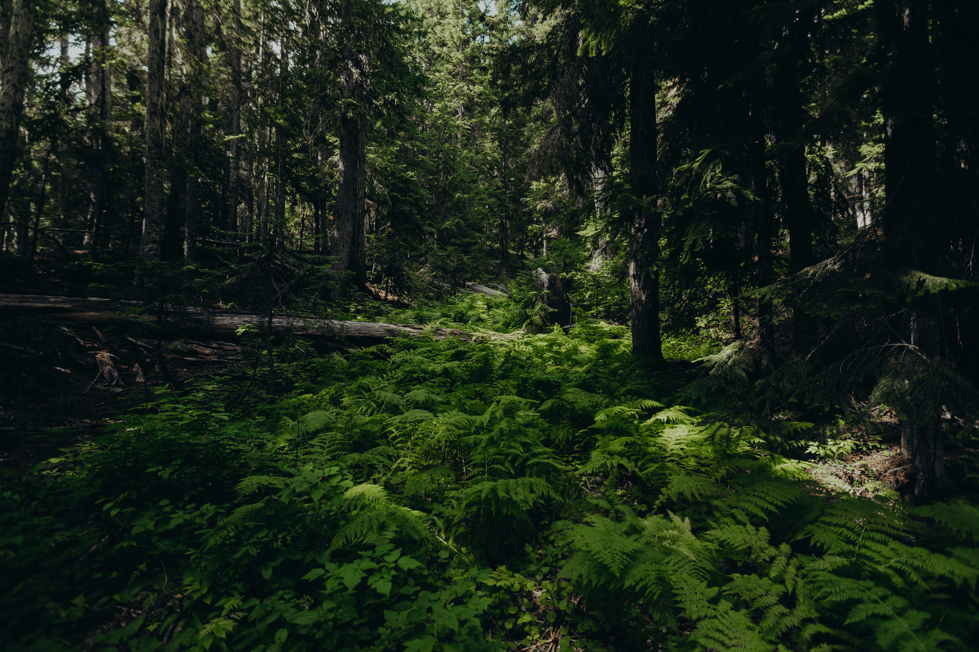
Green Technology
For
Sustainable
Development
Group 5

Slide 2
Green Technology
For
Sustainable
Development
Group 5

Slide 3

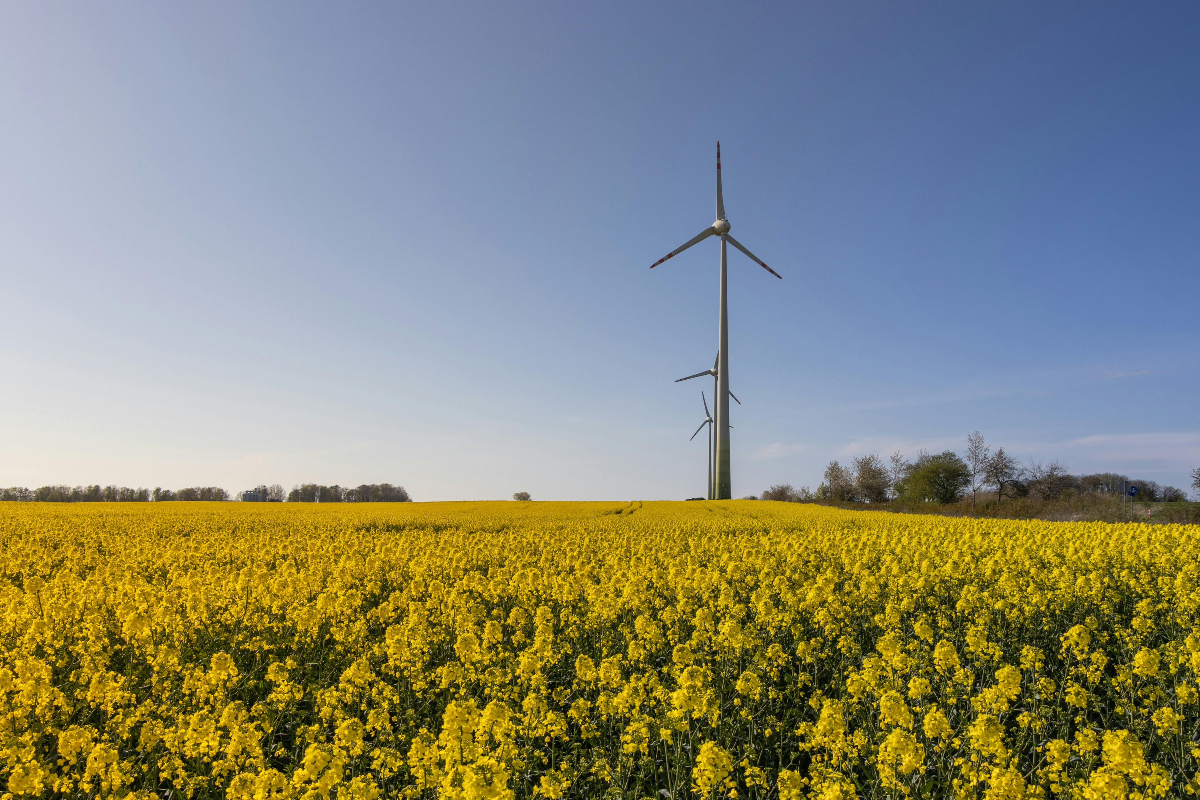
Green Technology For Sustainable Development
1/11
Introduction to green technology
01
02
03
04
05
06
07
08
09
10
11
Need for sustainable development
Green buildings and smart cities
Artificial photosynthesis in green technology
Green data centers using AI
Green technology in agriculture and food security
Social, economic perspectives
Climate adaptation technologies
Green Transport and mobility innovations
Challenges and future directions
Conclusion

Slide 4
1/11
Introduction to
Green
Technology
2/11
01
02
03
04
05
06
07
08
09
10
11
Need for sustainable development
Green buildings and smart cities
Artificial photosynthesis in green technology
Green data canters using AI
Green Technology – eco-friendly innovations
Reduces environmental impact
Promotes renewable energy use
Sustainable Development – future-focused growth
Meets present needs responsibly
Balances economy and environment
Green technology supports sustainability
Green technology in agriculture and food security
Social, economic perspectives
Climate adaptation technologies
Green Transport and mobility innovations
Challenges and future directions
Conclusion

Slide 5
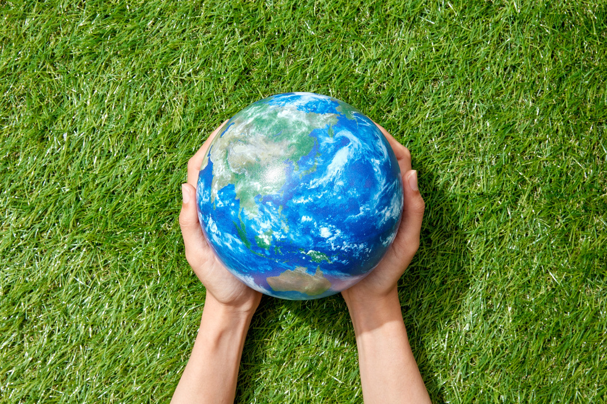
2/11
1/11
3/11
Conservation of Natural Resources
Environmental Protection
Economic Stability
Social Equality
Reduction of Climate Change Effects
Protection of Biodiversity
Long-Term Development
Need for
sustainable
development
01
02
03
04
05
06
07
08
09
10
11
Need for sustainable development
Green buildings and smart cities
Artificial photosynthesis in green technology
Green data canters using AI
Green technology in agriculture and food security
Social, economic perspectives
Climate adaptation technologies
Green Transport and mobility innovations
With great Power comes
Great responsibility
- Sourav
Challenges and future directions
Conclusion

Slide 6
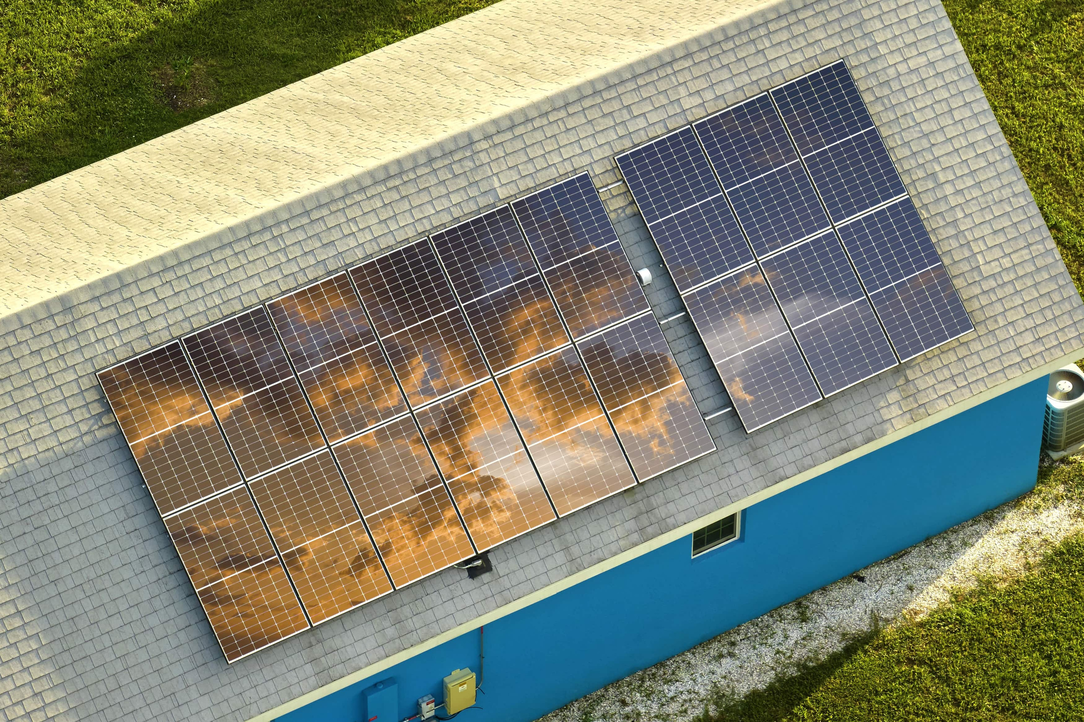
2/11
3/11
1/11
4/11
Smart Cities
01
02
03
04
05
06
07
08
09
10
11
Need for sustainable development
Economic Sustainability
Environmental Sustainability
Social Sustainability
Green buildings and smart cities
Artificial photosynthesis in green technology
Green data canters using AI
Green Buildings
Green technology in agriculture and food security
Economic Pillar
Environmental Pillar
Social Pillar
Social, economic perspectives
Climate adaptation technologies
Green Transport and mobility innovations
Challenges and future directions
Green Buildings and Smart Cities
Conclusion

Slide 7
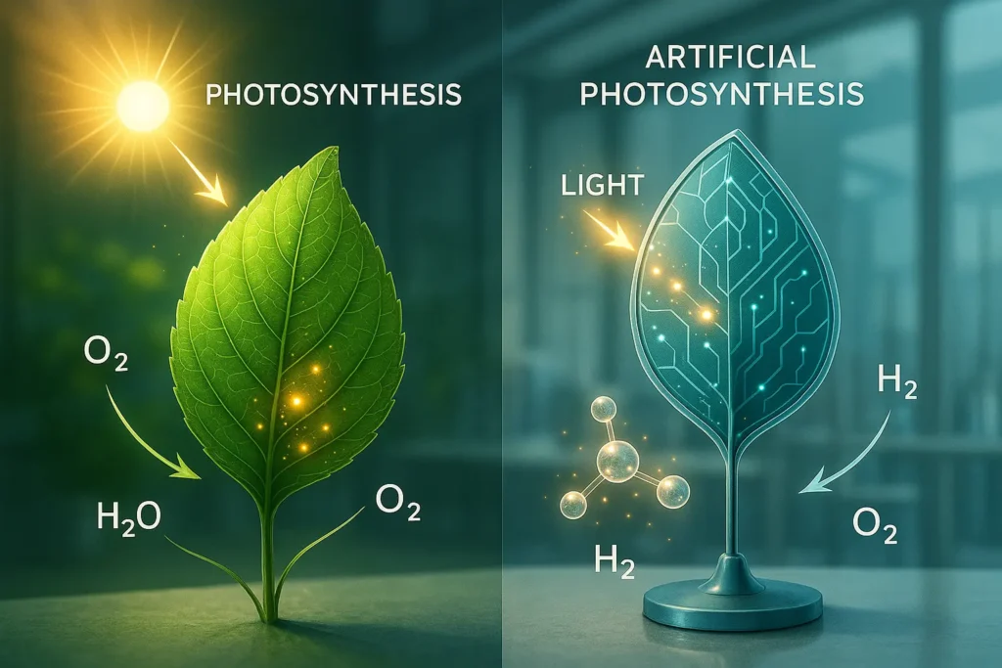
2/11
3/11
4/11
1/11
5/11
Artificial photosynthesis
in Green Technology
01
02
03
04
05
06
07
08
09
10
11
Need for sustainable development
Green buildings and smart cities
Artificial photosynthesis in green technology
Copying Nature
​Storing Sunlight
Cleaning the Air
Better than Plants
​Green Fuel for Big Machines
Green data canters using AI
Green technology in agriculture and food security
Social, economic perspectives
Climate adaptation technologies
Green Transport and mobility innovations
Challenges and future directions
Conclusion

Slide 8
2/11
3/11
4/11
1/11
5/11
Artificial photosynthesis
in Green Technology
01
02
03
04
05
06
07
08
09
10
11
Need for sustainable development
Green buildings and smart cities
Artificial photosynthesis in green technology
Applications
Major Uses
Green data canters using AI
Green Hydrogen Production
Synthetic Hydrocarbons
Carbon-Neutral Plastics
Green Ammonia
Sustainable Fragrances & Fine Chemicals:
Decentralized Fuel Refineries
Industrial Carbon Recycling
Green technology in agriculture and food security
Social, economic perspectives
Climate adaptation technologies
Green Transport and mobility innovations
Challenges and future directions
Conclusion

Slide 9
2/11
3/11
4/11
1/11
5/11
Artificial photosynthesis
in Green Technology
01
02
03
04
05
06
07
08
09
10
11
Need for sustainable development
Green buildings and smart cities
Artificial photosynthesis in green technology
Advantages
Disadvantages
Green data canters using AI
Energy Storage
Carbon Negative
High Energy Density
Superior Efficiency
Land Use
High Initial Cost
Low Market Maturity
Green technology in agriculture and food security
Social, economic perspectives
Climate adaptation technologies
Green Transport and mobility innovations
Challenges and future directions
Conclusion

Slide 10
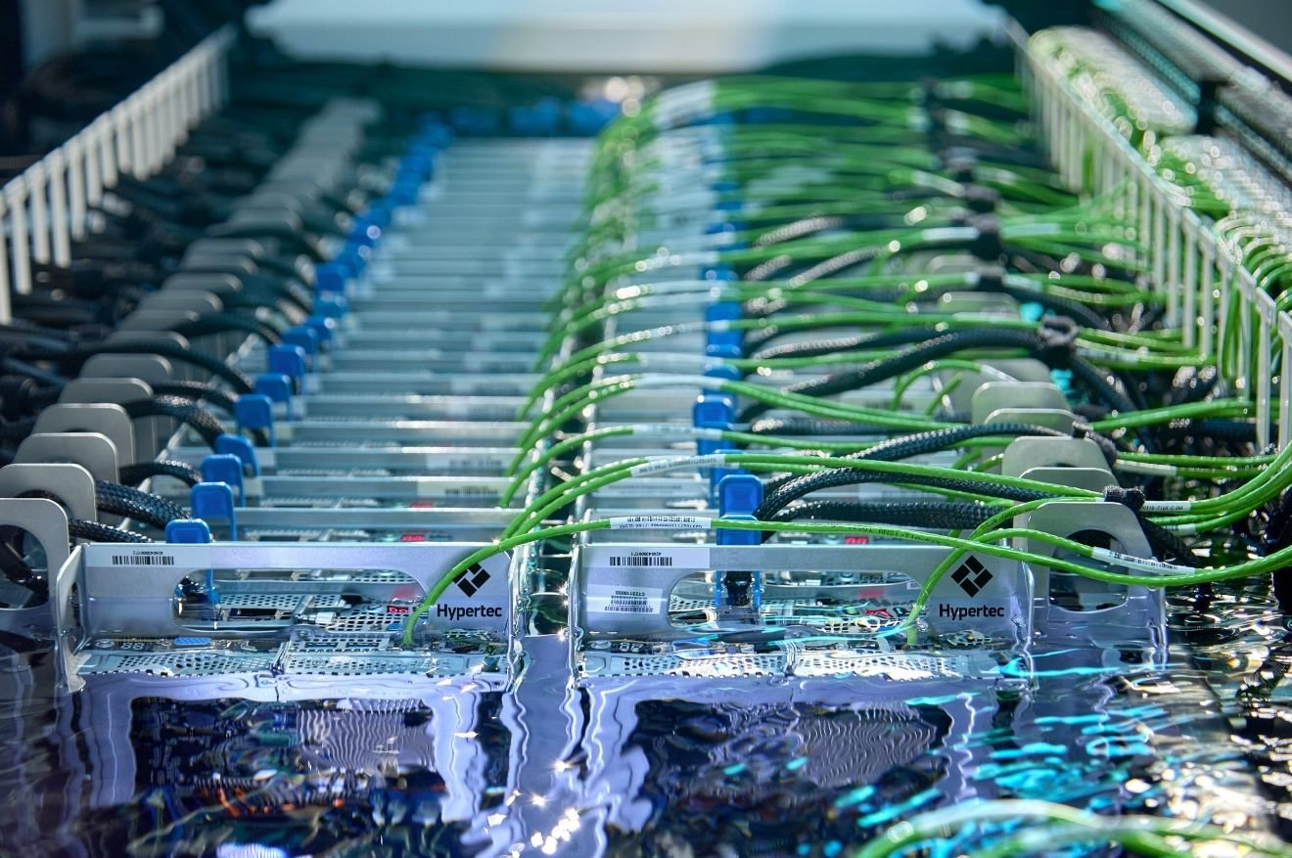
5/11
2/11
3/11
4/11
1/11
6/11
Green data centers
using AI
01
02
03
04
05
06
07
08
09
10
11
Need for sustainable development
Introduction
Energy-Efficient Cooling
Smart Power Management
Renewable Energy Integration
Predictive Maintenance
Environmental Benefits
Real-World Examples
Green buildings and smart cities
Artificial photosynthesis in green technology
Green data canters using AI
Green technology in agriculture and food security
Social, economic perspectives
Climate adaptation technologies
Green Transport and mobility innovations
Challenges and future directions
Conclusion

Slide 11
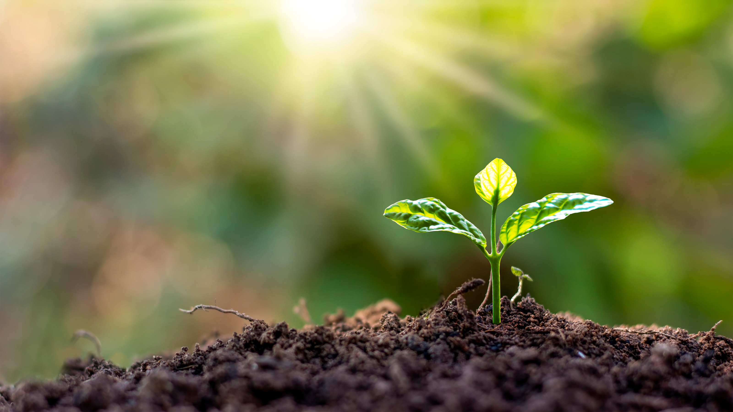
5/11
2/11
3/11
4/11
6/11
1/11
7/11
Green technology
in agriculture
and Food Security
01
02
03
04
05
06
07
08
09
10
11
Need for sustainable development
Green buildings and smart cities
Precision Farming
Indoor Growing
Stronger Crops
Saving Resources
Reducing Waste
Artificial photosynthesis in green technology
Green data canters using AI
Green technology in agriculture and food security
Social, economic perspectives
Climate adaptation technologies
Green Transport and mobility innovations
Challenges and future directions
Conclusion

Slide 12

5/11
2/11
3/11
4/11
6/11
7/11
1/11
8/11
Introduction
A Historical Perspective
Job Creation
Impact on Poor Communities
Health & Social Benefits
Government & Policy Support
Conclusion
Social &
Economic
Perspectives
01
02
03
04
05
06
07
08
09
10
11
Need for sustainable development
Green buildings and smart cities
Artificial photosynthesis in green technology
Green data canters using AI
Green technology in agriculture and food security
Social, economic perspectives
Climate adaptation technologies
Green Transport and mobility innovations
Challenges and future directions
Conclusion

Slide 13
Introduction
A Historical Perspective
Job Creation
Impact on Poor Communities
Health & Social Benefits
Government & Policy Support
Conclusion
5/11
2/11
3/11
4/11
6/11
7/11
8/11
1/11
9/11
Climate change causes:
Adaptation technologies :
01
02
03
04
05
06
07
08
09
10
11
Heavy rainfall and floods
Extreme heat
Drought and water shortage
Strong storms
Flood barriers to protect cities
Cool roofs to reduce heat
Drip irrigation to save water
Rainwater harvesting systems
Need for sustainable development
Green buildings and smart cities
Artificial photosynthesis in green technology
Green data canters using AI
Green technology in agriculture and food security
Climate Adaptation
Technologies
Social, economic perspectives
Climate adaptation technologies
Green Transport and mobility innovations
Challenges and future directions
Conclusion

Slide 14
5/11
2/11
3/11
4/11
6/11
7/11
8/11
1/11
9/11
Why It Is Important?
01
02
03
04
05
06
07
08
09
10
11
Reduces damage from floods and storms
Helps farmers grow crops during drought
Protects people from extreme heat
Saves and manages water properly
Protects houses, roads, and buildings
Reduces risk to human life
Need for sustainable development
Green buildings and smart cities
Artificial photosynthesis in green technology
Green data canters using AI
Green technology in agriculture and food security
Climate Adaptation
Technologies
Social, economic perspectives
Climate adaptation technologies
Green Transport and mobility innovations
Challenges and future directions
Conclusion

Slide 15
Introduction
A Historical Perspective
Job Creation
Impact on Poor Communities
Health & Social Benefits
Government & Policy Support
Conclusion
5/11
2/11
3/11
4/11
6/11
7/11
8/11
9/11
1/11
Green Transport and
mobility innovations
10/11
01
02
03
04
05
06
07
08
09
10
11
Need for sustainable development
Green buildings and smart cities
Artificial photosynthesis in green technology
Concept
Environment-friendly transportation system
Reduces air pollution and carbon emissions
Uses clean energy sources
Promotes sustainable mobility
Key Innovations:
Electric Vehicles (EVs)
Hydrogen fuel vehicles
Biofuel-based transport
Smart public transport systems like Metro
Green data canters using AI
Green technology in agriculture and food security
Social, economic perspectives
Climate adaptation technologies
Green Transport and mobility innovations
Challenges and future directions
Conclusion

Slide 16
Introduction
A Historical Perspective
Job Creation
Impact on Poor Communities
Health & Social Benefits
Government & Policy Support
Conclusion
5/11
2/11
3/11
4/11
6/11
7/11
8/11
9/11
1/11
Green Transport and
mobility innovations
10/11
01
02
03
04
05
06
07
08
09
10
11
Need for sustainable development
Green buildings and smart cities
Artificial photosynthesis in green technology
Green data canters using AI
Impact & Benefits:
Improves air quality
Saves energy
Reduces fuel dependency
Lowers traffic congestion
Supports sustainable development
Future of Green Mobility:
Autonomous electric vehicles
Electric air taxis
Advanced battery technology
Smart transport networks
Green technology in agriculture and food security
Social, economic perspectives
Climate adaptation technologies
Green Transport and mobility innovations
Challenges and future directions
Conclusion

Slide 17
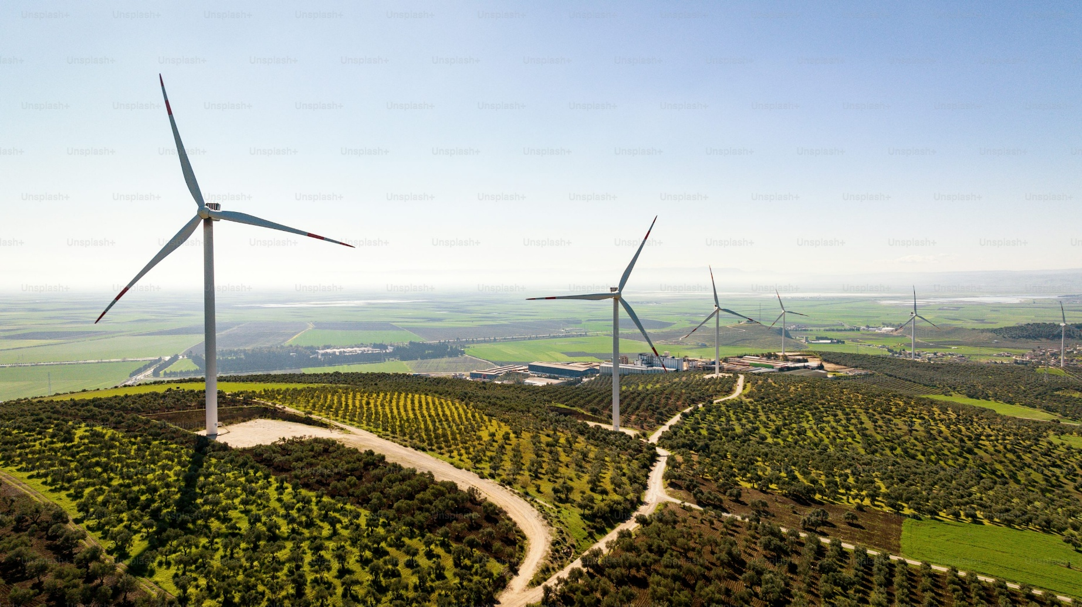
Introduction
A Historical Perspective
Job Creation
Impact on Poor Communities
Health & Social Benefits
Government & Policy Support
Conclusion
5/11
2/11
3/11
4/11
6/11
7/11
8/11
9/11
10/11
1/11
11/11
Challenges
High initial cost
Lack of awareness
Technological Limitations
Infrastructure Problems
Future Directions
Improvement in renewable Energy
Green Hydrogen Energy
Electric Vehicle Growth
Waste to Energy Technology
01
02
03
04
05
06
07
08
09
10
11
Need for sustainable development
Green buildings and smart cities
Artificial photosynthesis in green technology
Green data canters using AI
Green technology in agriculture and food security
Social, economic perspectives
Challenges &
Future directions
Climate adaptation technologies
Green Transport and mobility innovations
Challenges and future directions
Conclusion

Slide 18
Introduction
A Historical Perspective
Job Creation
Impact on Poor Communities
Health & Social Benefits
Government & Policy Support
Conclusion
5/11
2/11
3/11
4/11
6/11
7/11
8/11
9/11
10/11
11/11
1/11
Sustainable development protects resources for future generations.
Green technology reduces pollution and carbon emissions.
Green buildings, smart cities, and transport improve energy efficiency.
Artificial photosynthesis and AI data centers support clean energy.
Sustainable agriculture ensures food security and resource conservation.
Climate adaptation technologies address climate change impacts.
Innovation and strong policies can build a greener future.
01
02
03
04
05
06
07
08
09
10
11
Need for sustainable development
Green buildings and smart cities
Artificial photosynthesis in green technology
Green data canters using AI
Green technology in agriculture and food security
Social, economic perspectives
Conclusion.
Climate adaptation technologies
Green Transport and mobility innovations
Challenges and future directions
Conclusion

Slide 19
1/11
3 /11
Need for sustainable development
Green buildings and smart cities
Artificial photosynthesis in green technology
Green data canters using AI
Green technology in agriculture and food security
Social, economic perspectives
Climate adaptation technologies
Green Transport and mobility innovations
Challenges and future directions
With great Power comes Great responsibility
- Sourav
Conclusion

